Slide 1
A Matrix for Video Game Collecting
Caylin Smith, Digital Preservation Manager
Cambridge University Library, @CaylinSSmith
Stephen McConnachie, Head of Data and Digital Preservation British Film Institute, @mcnatch
#NTTW4 / Budapest / December 6th 2019
Notes:
CS
Introduce CS and SM
Introduce talk
Trying to think through how to collect, preserve, and provide access to UK video game history
If we did collect a game, what would the look like? What would we / other organisations need to collect to say that a game has been successfully collected?
Time for questions afterward
Feedback on presentation, where to head next

Slide 2
Outline
Introducing the challenge
Why Collecting Video Games is Complex
Preservation and Access subgroup
Collecting matrix
Template
Hellblade case study
Next steps
Notes:
SM

Slide 3
Introducing the Challenge
What would a distributed national initiative to collect, preserve, and provide access to video games look like?
Consortium of collecting organisations:
BFI, British Library, Tate, V&A, Science Museum Group, Wellcome Collection, Museum of London, British Games Institute, National Videogame Museum
Three subgroups
Preservation and Access
Advocacy
Strategy
Notes:
SM

Slide 4
Why Collecting Video Games is Complex
Defining the work
Looking at who’s collecting games in the UK and abroad
Preservation work outside the context of collecting organisations
Heavily proprietary game companies
Pirate community
Knowing / anticipating what users want to access
Notes:
CS
Questions from the wider group
Defining the work
Software, hardware, peripherals, fan culture
Shift to gaming as a service → impact of not being able to collect the game media → something that will impact collecting more broadly, especially in regards to software preservation
Finding out who’s collecting games outside of the UK
Are our challenges already solved?
Preservation work happening outside the context of collecting organisations
Heavily proprietary commercial companies
Competing technologies leading to rapid obsolescence
Solving the problem, but not sharing the solution for the preservation community to benefit
Do we not focus on these companies and instead make the assumption that preservation is likely happening? Focus on smaller companies, niche but culturally significant video games
Should our focus be games whose code is open source and cross platform compatible
Pirate community ahead with emulation and metadata schemas
Risks of getting involved or not getting involved
Could antagonise rights holders or compromise our funding opportunities
Knowing / anticipating what users want to access

Slide 5
Preservation and Access Subgroup
Deciding what to collect
Fit with collecting remit
Collecting could mean different things to different institutions
How to create the bigger picture
How do you coordinate multiple organisations that want to collect the same work?
Communicating complexities to government and other funding bodies
Engagement with industry and makers
Orphan works licence for video games
Notes:
CS
Questions that have come up specifically within this group
Deciding what to collect
Fit with collecting policy / remit
Achievable and sustainable with workplace skills and infrastructure
Planned lifecycle and managing preservation and access over time
Ties back into what an organisation is entitled to collect and its remit, but also what their users want to access and use the collection
These things might not necessarily align
How to create the bigger picture
How do you coordinate multiple organisations that want to collect the same work?
Communicating complexities to government and other funding bodies
Engagement with industry and makers
Orphan works licence for video games
copyright works where one or more of the right holders are unknown or cannot be located
In the UK, such a license exists for film, music, and sound → could it exist for games as well as and aid in their preservation and access

Slide 6
Collecting Matrix
bit.ly/videogamesmatrix
Notes:
SM

Slide 7
obligatory quote from The Matrix
You take the red pill
you stay in wonderland
and I show you
how deep
the rabbit hole goes
You take the blue pill
the story ends
you wake up
in your bed and
believe in whatever
you want to believe
Notes:
SM

Slide 8
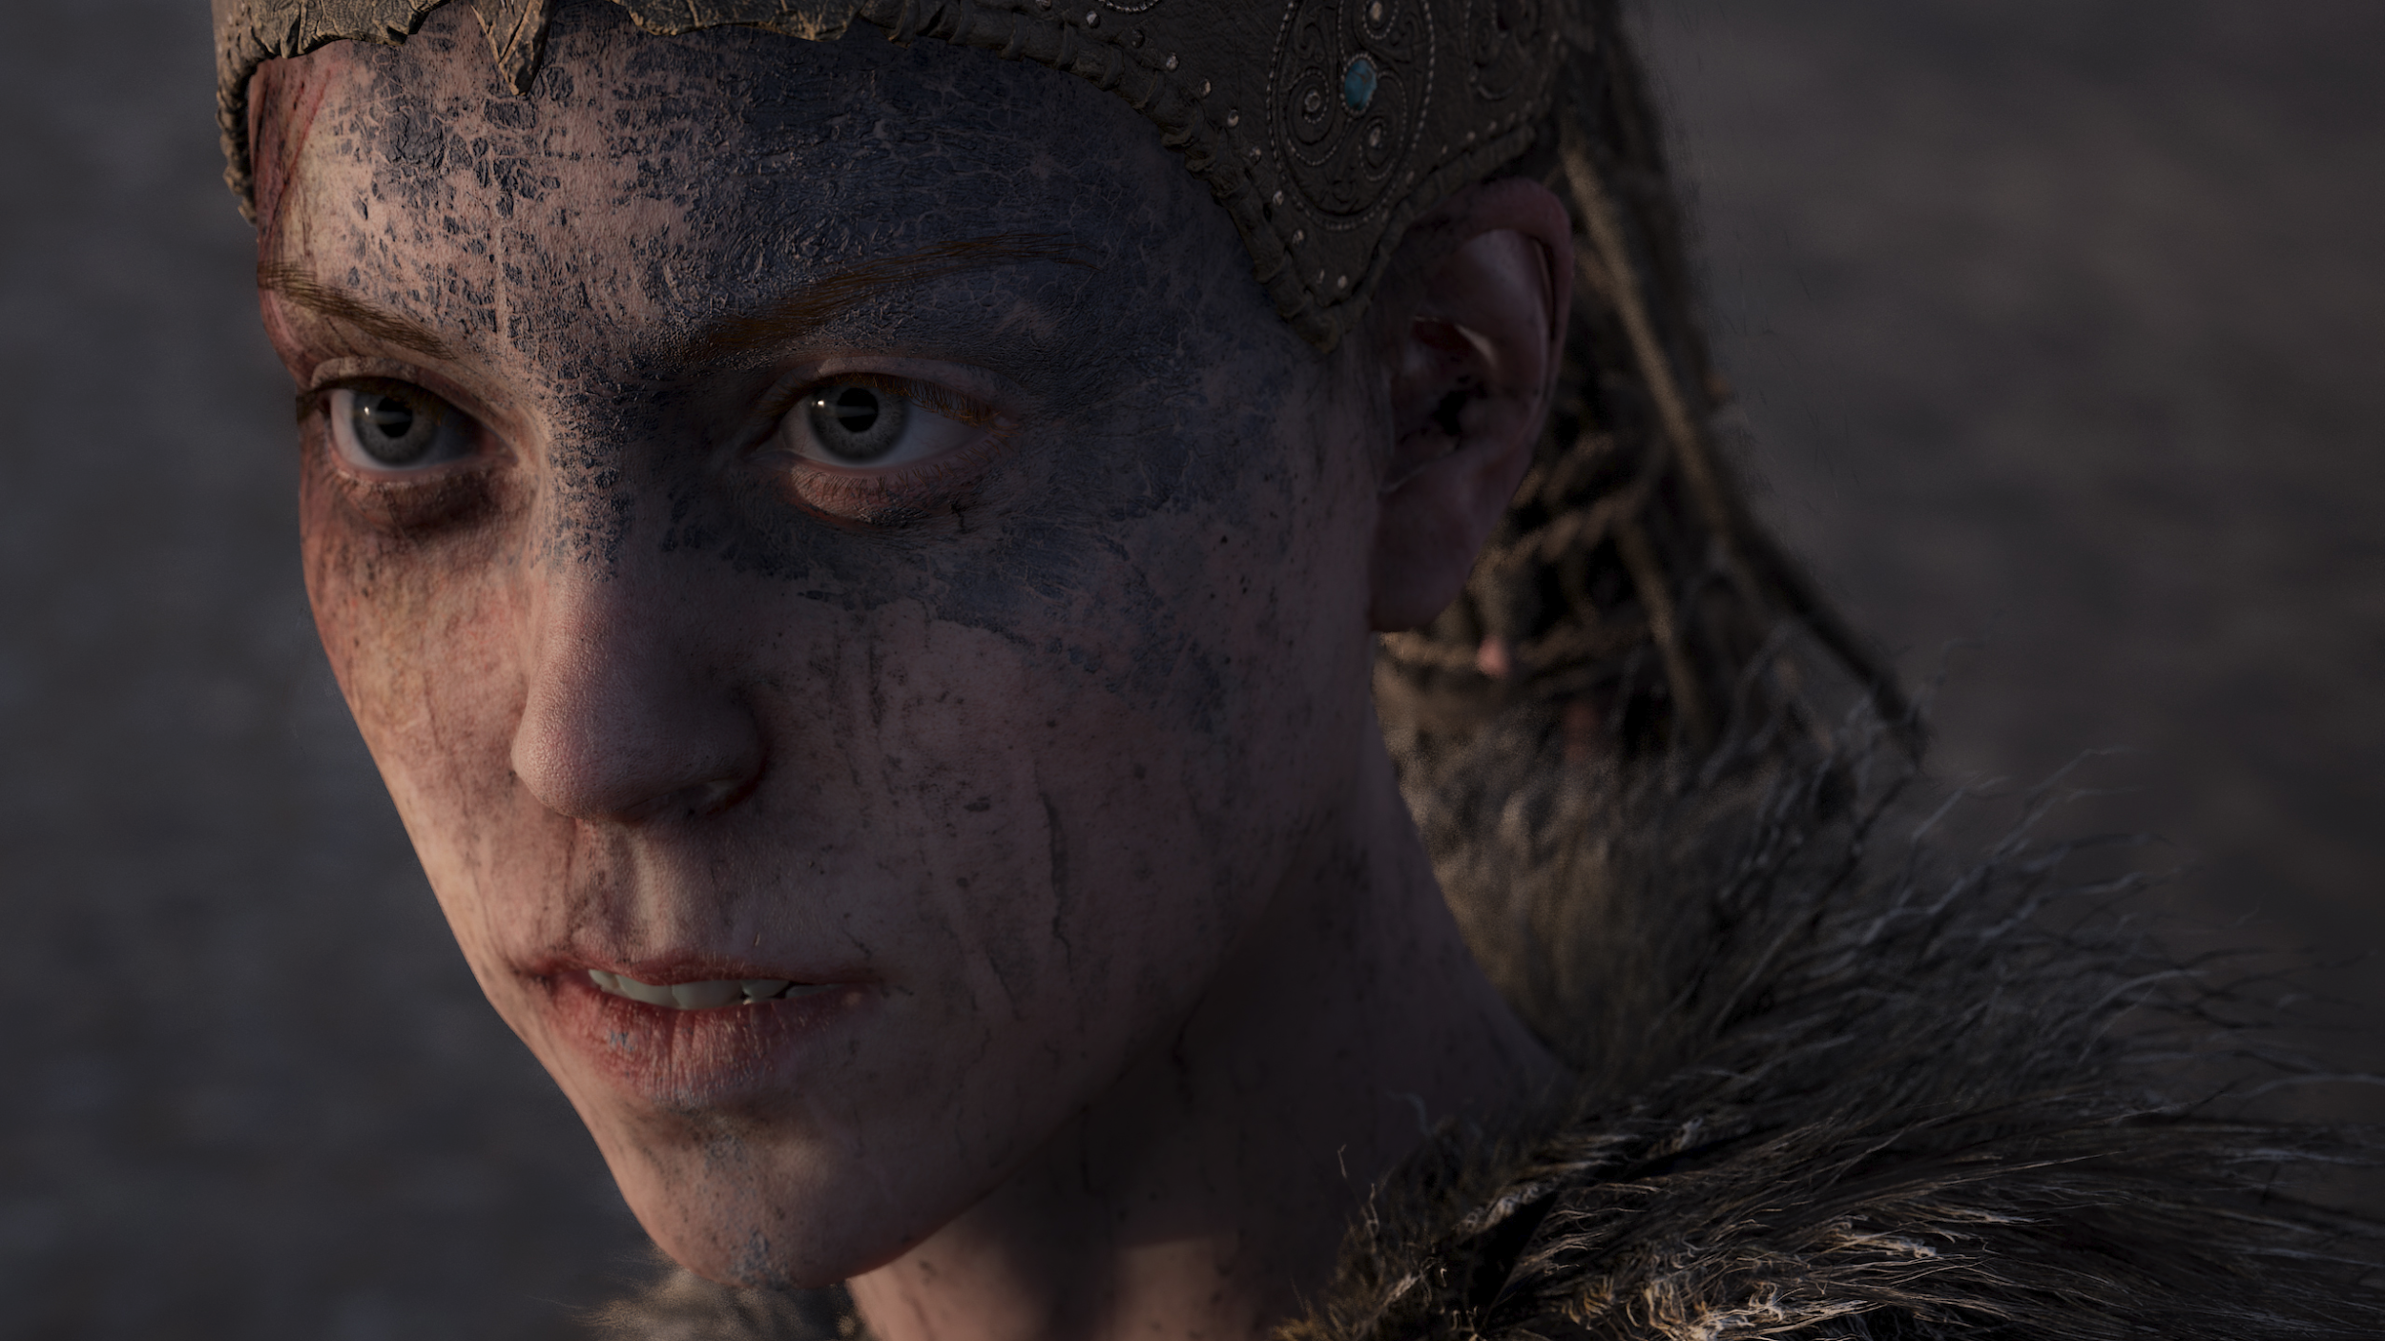
Notes:
SM

Slide 9
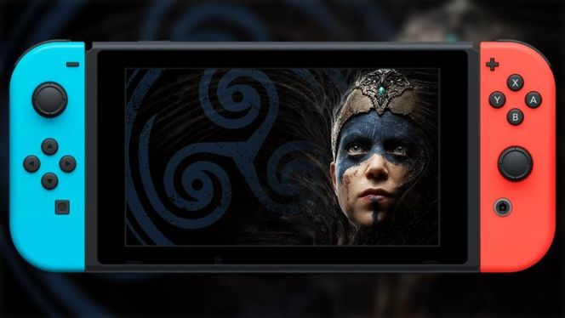
Hardware
Physical device that outputs a video signal to display a video game
Hellblade
Created for PC, then PS4, then XBox1, then Nintendo Switch
PC and PS4 versions have VR component
Notes:
CS
Physical device that outputs a video signal to display a video game
Hellblade
Created for PC, then PS4, then XBox1, then Nintendo Switch.
PC and PS4 versions have VR component, other versions don't - so a collecting question.
Image from: https://thegeek.games/2019/02/14/nintendo-direct-hellblade-senuas-sacrifice-switch-psychosis-video/

Slide 10
Controllers
Input device for video games
Hellblade
Standard proprietary controllers for all versions
Keyboard for PC version
Notes:
CS
Input device for video games
Hellblade
Standard proprietary controllers for all versions, nothing specific such as guitar hero. However, for VR versions VR-specific controllers apply.

Slide 11
Source code
Code written using a human-readable programming language
Hellblade
Ninja Theory (UK-based) are developer and rightsholder, so we could assume they retained all source code
Where / how is the code stored? Would it make sense to an organisation trying to collect the game?
Notes:
CS

Slide 12
Released code
Executable files interpreted by the console
Hellblade
Released physically on disc, but the updates are not
Typical model for disc-based games
Updates over internet are more common when playing disc-based game
'Day 1 patch' followed by bugfix patches when needed
Notes:
CS

Slide 13
Patch notes
Documentation of updates - released alongside the update - on Twitter or Steam, or in-game popup, or elsewhere online.
Hellblade
Release and patch notes on Hellblade website
Notes:
CS
If impossible to collect all updates, then these would represent a different asset to collect.

Slide 14
DLC (downloadable content)
Additional content (e.g. expansion packs) created by developer for download over the internet
Hellblade
No downloadable content for this game
Notes:
CS

Slide 15
Packaging
Could include, but not limited to:
Plastic case w/ cover
System requirements
Health warning
Physical instructions
Hellblade
Physical case w/
Cover and disc inside
System requirements
Health warning
Notes:
CS
Could include, but not limited to:
Plastic case, as typical in most modern games - health warning typically inside. No longer common to get instruction materials inside packaging. However in some cases the physical instructions become an added value selling proposition. Limited Run for example send limited sets of physical games for eg hundreds of dollars.

Slide 16
Gameplay accessories
Specialty input devices to need to play a game
e.g. VR headsets, steering wheels
Hellblade
VR-specific controllers apply for VR versions
Notes:
CS

Slide 17
Enhancement devices
Older games - plug ins for power boost, for example.
Nintendo 64 and Sega Saturn boost allowed higher resolution gameplay.
Hellblade
No devices - less relevant for modern games
Notes:
SM

Slide 18
Marketing materials
Broad range of material types:
press kit
moving image trailer
website
wallpapers
etc
Hellblade
all of the above, and more
marketing as a rich art form
Notes:
SM

Slide 19
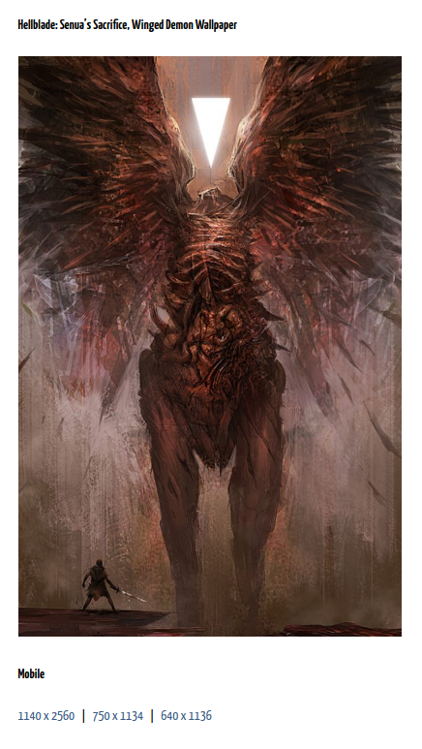
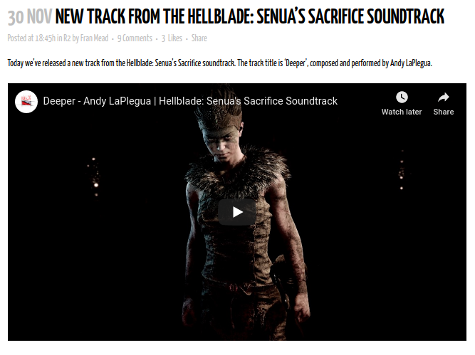
Marketing materials
Notes:
SM

Slide 20
Notes:
SM

Slide 21
Collectibles and ephemera
Huge range of collectibles:
t-shirts, hoodies
posters
soundtracks released separately, even on vinyl
Hellblade
all of the above, plus...
scented candles
Notes:
SM

Slide 22
Collectibles and ephemera
.
Notes:
SM

Slide 23
Design documentation
'Game design document', comprising
gameplay
character modelling and development
lore of the game world
storyboarding for narrative-heavy games
concept art
script
Hellblade
all of the above, plus Development Diary videos
Notes:
SM

Slide 24
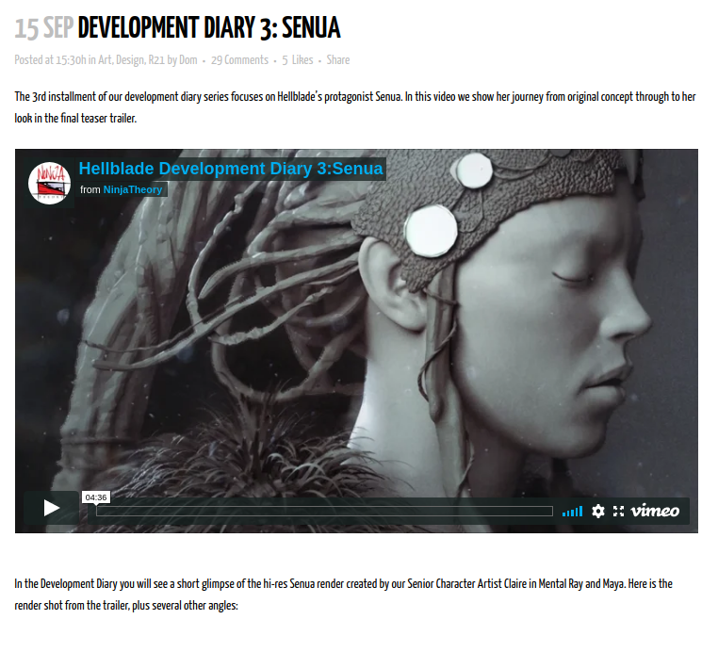
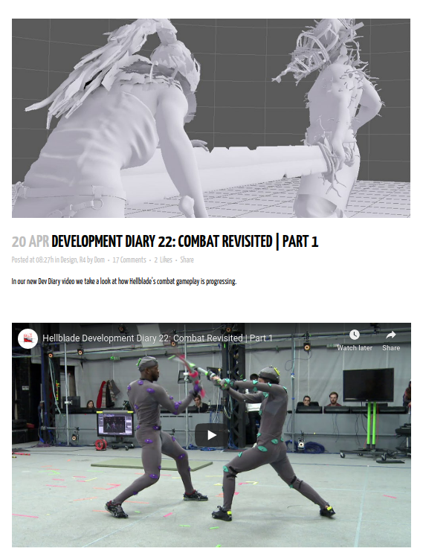
Design documentation
Notes:
SM

Slide 25
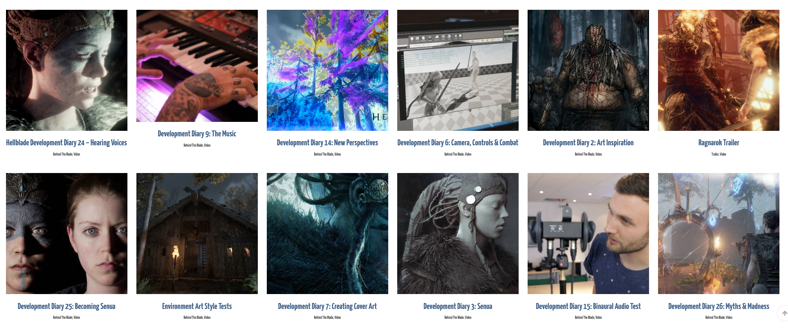
Design documentation
Notes:
SM

Slide 26
Fan-produced materials
Expos, cosplay, fanart, etc.
digital or physical
sometimes official component eg cosplay guide
pinterest boards, facebook groups
Hellblade
plentiful cosplay
even an official guide by Ninja Theory
Notes:
SM

Slide 27
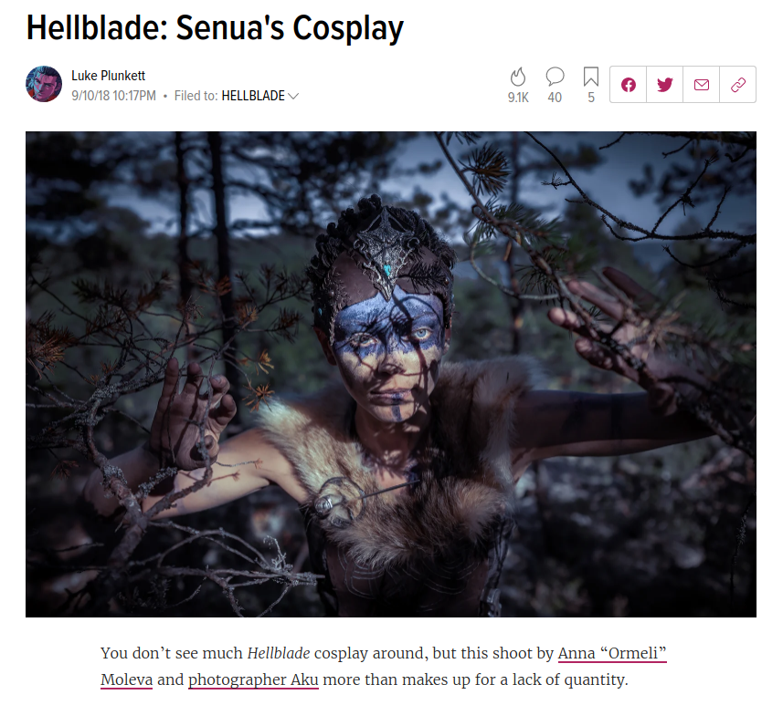
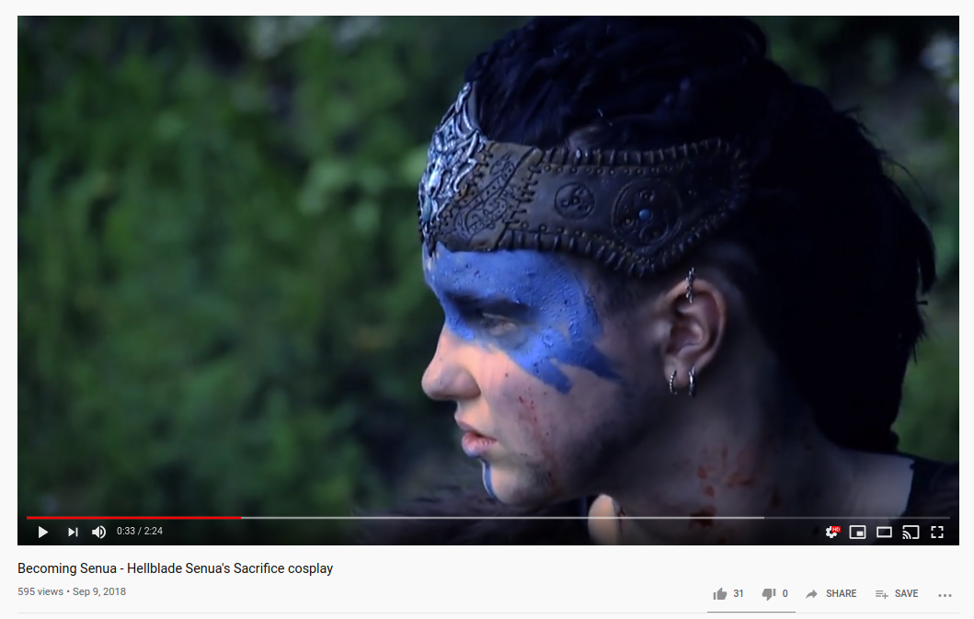
Fan-produced materials
Notes:
SM

Slide 28
Walkthroughs and guides
Digital online walkthroughs and guides, made by fans and professional sites such as IGN.
Also still published guidebooks, and artbooks.
Hellblade
fan-created, on YouTube, Vimeo, etc
IGN professional guides
Notes:
SM

Slide 29
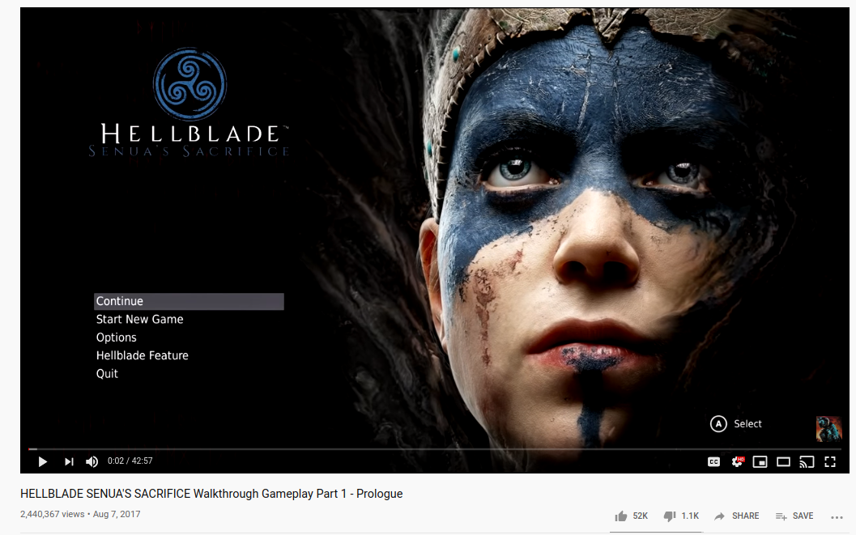
Walkthroughs and guides
Notes:
SM

Slide 30
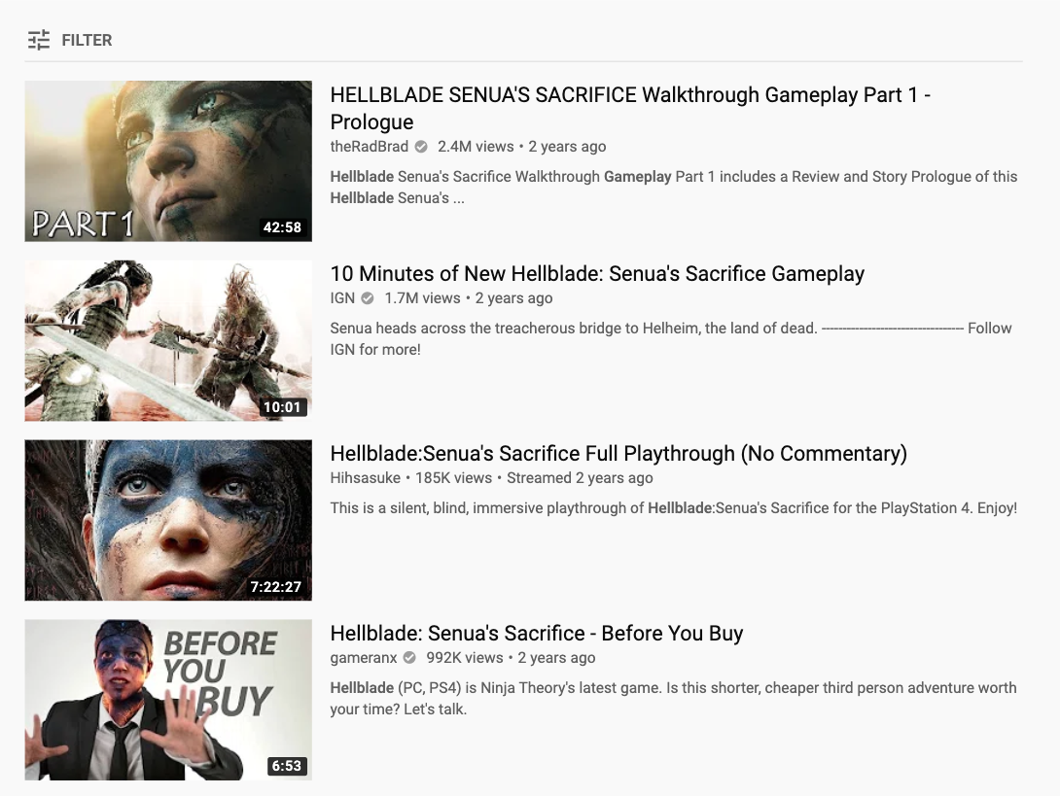
Gameplay video
Video footage of the game
E.g. promotional trailer
Fan-produced gameplay video
Crossover with walkthroughs and guides
Notes:
SM
Some footage of gameplay (eg from promotional trailer) may be all that remains from lost games. Check fair use or similar for online gameplay, possibly.
Image is screen grab from YouTube

Slide 31
Next Steps
Develop a subject specialist network (SSN)
Build networks of other collecting organisations
Engage pirate community (...maybe...)
Test matrix for Hellblade
Apply matrix and case studies to designing a data model
Notes:
Sm

Slide 32
Thank you!
Caylin Smith
cs2059@cam.ac.uk
Stephen McConnachie
Stephen.McConnachie@bfi.org.uk
Thanks to Stuart Burnside, Ninja Theory, and NTTW programme committee for making this presentation possible
Notes:
SM

